Slide 1

Zephyr Workshop – BLE
Two-board setup for hands-on BLE development

Slide 2

What is BLE?
Bluetooth Low Energy = short-range, low-power wireless communication
Used in wearables, sensors, smart home devices
Optimized for brief data exchange sessions

Slide 3



BLE Roles in Zephyr
Peripheral
Central
Data Exchange
Broadcasts services
Scans for peripherals
Read/write/notify
Advertises availability
Initiates connections
GATT characteristics

Slide 4

Advertising & Scanning
Peripheral broadcasts name & UUID
Central scans and parses
Power vs interval tradeoffs

Slide 5
Connection Process (GAP)
Link Established
CONNECT_REQ
Data exchange begins
Advertising
Central initiates connection
Peripheral broadcasts availability
Parameters: interval, latency, timeout

Slide 6
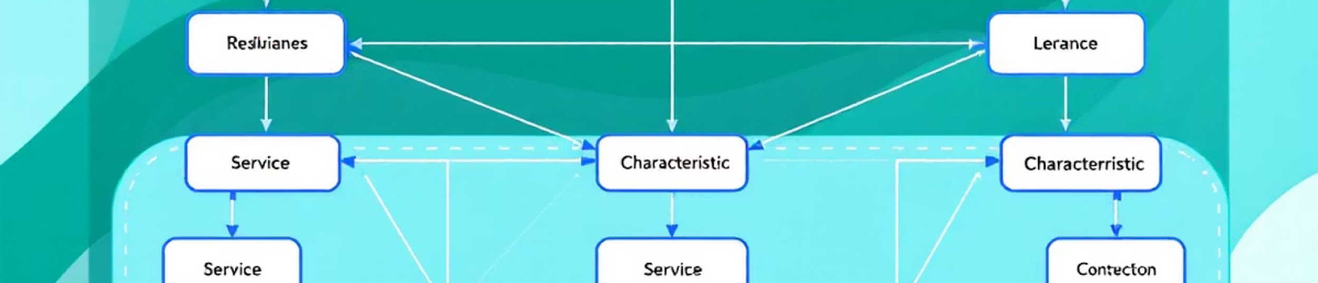
GAP and GATT Overview
GAP
GATT
Generic Access Profile
Generic Attribute Profile
Handles discovery & connections
Data structure: services & characteristics

Slide 7

Peripheral: Publishing Data
Use GATT services
Heart Rate Service example
Notifications = async data push from server to client

Slide 8
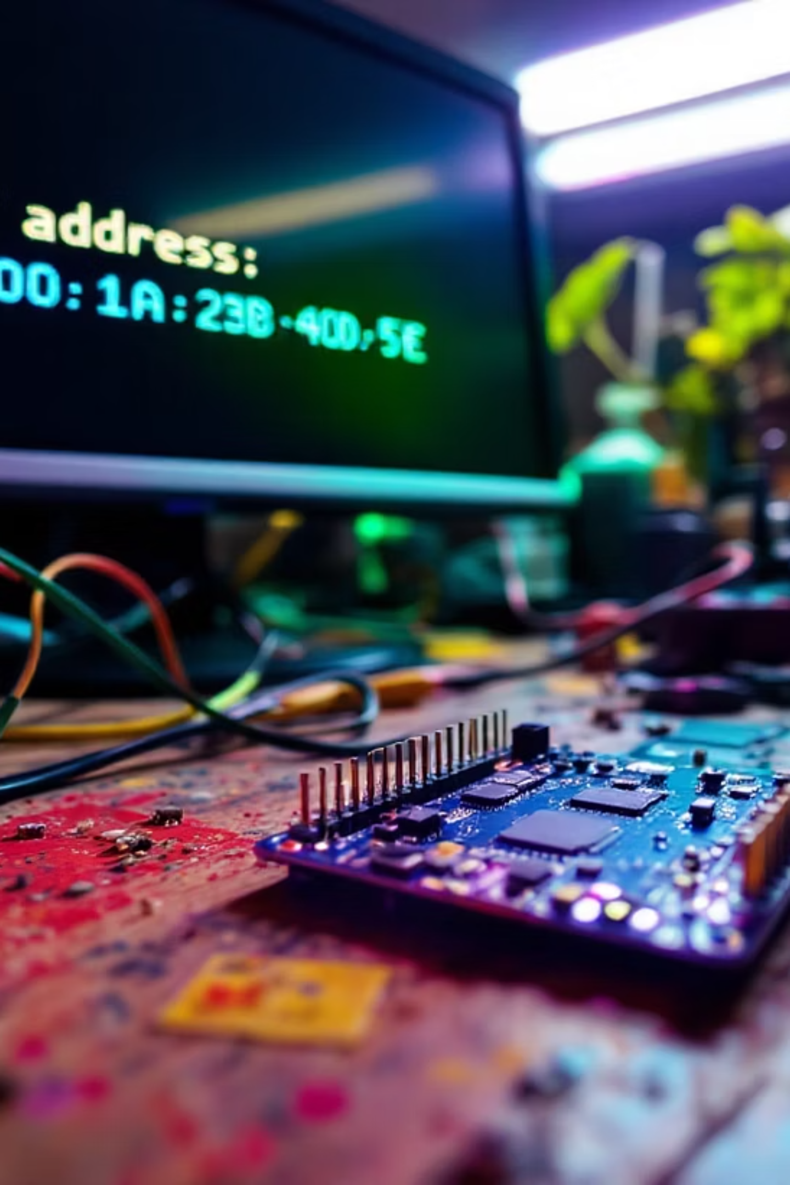
BLE Sample: Peripheral HR
Path: samples/bluetooth/peripheral_hr
Board: nrf52dk/nrf52832
west build -b nrf52dk/nrf52832 samples/bluetooth/peripheral_hr
west flash
Save the peripheral mac addr printed on the screen

Slide 9
Central: Receiving Data
Scan
1
Find Heart Rate Service advertisers
2
Connect
Establish link with peripheral
Discover
3
Find services & characteristics
4
Subscribe
Enable notifications
Receive
5
Process heart rate data

Slide 10
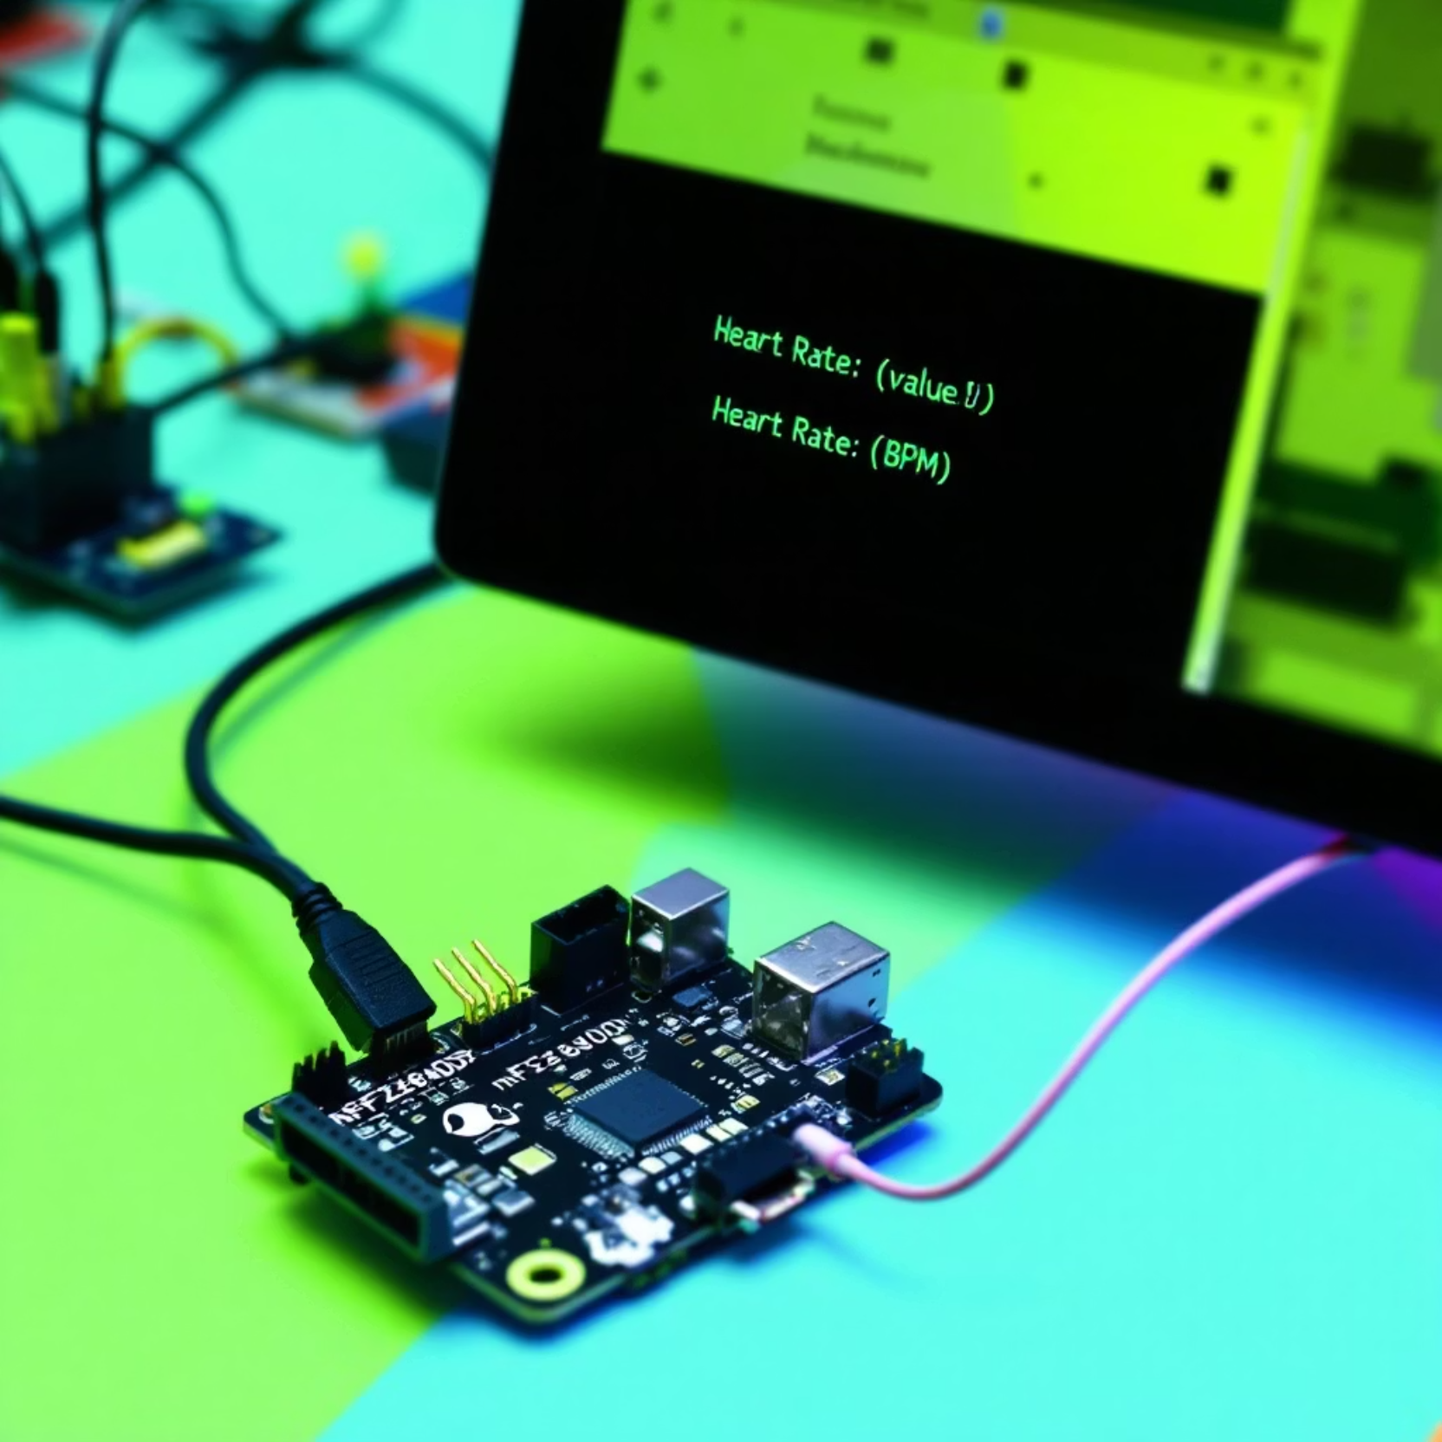
BLE Sample: Central HR
Path: samples/bluetooth/central_hr
Board: nrf52840dk/nrf52840
In device_found after the print add:
if (strncmp(dev, PERIPH_ADDR, 17) != 0)
{
printk(" (not ours)\n");
return;
}
printk("\n");
In notify_func:print the data[1] instead of data
Build and flash

Slide 11
Exercise Demo Steps
Connect both boards to USB
Flash peripheral_hr to nRF52DK
Flash central_hr to nRF52840DK
Open two terminals (e.g., minicom)
Observe advertisement, connection, and data transfer
Extra: change the freq of the advertisement so phone won’t see you (:

